Slide 1
Is the B1 bus late?
95 % of the time, the bus arrives and departs within 3 min of schedule.

Slide 2
The B1 timetable
The first B1 bus leaves Wynyard at 5.40 am with successive buses every 10-15 minutes
The last bus leaves Wynyard at 12.42 am

Slide 3
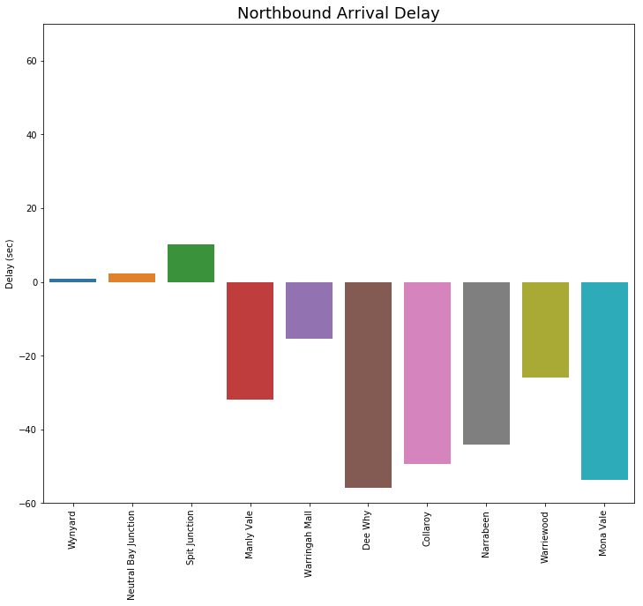
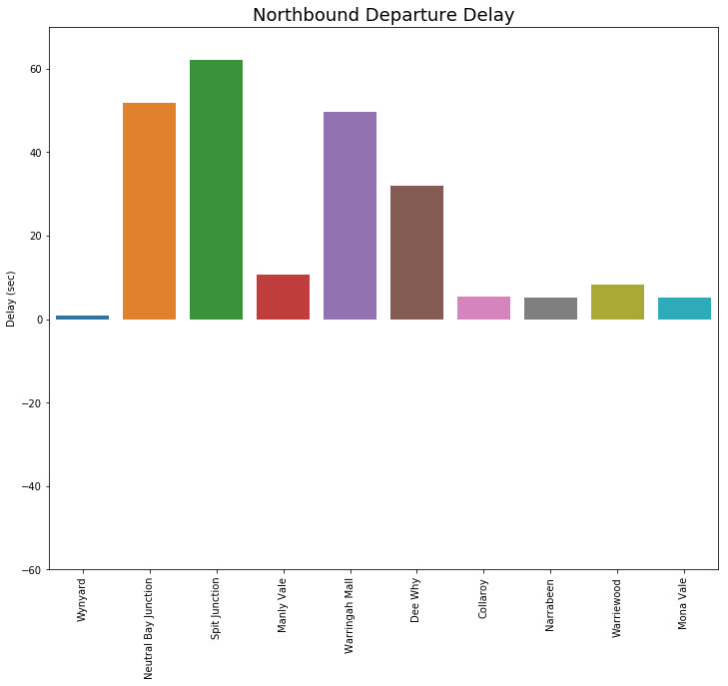
Average Delay for each stop
Late
Late
Early
Early
Notes:
On average, the B1 bus arrives at each stop early and departs late. The bus departs significantly late from Neutral Bay, Spit Junction and Warringah Mall. These stops are all major points with intersections, where people get off and go other directions, or pick up their cars.
The bus tends to arrive early at all stops from Manly Vale onwards.

Slide 4
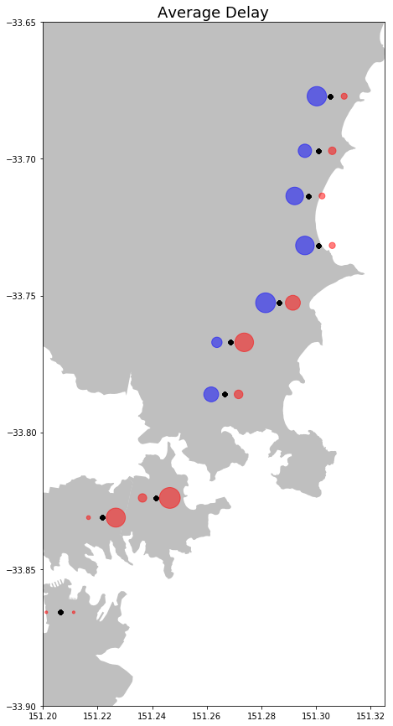
Average Delay for each stop
On average, the B1 bus is early.
The bus departs late from the first few stops.
More people / congestion plays a role in delay.
Left: Arrival Delay
Right: Departure Delay
Early, Late

Slide 5
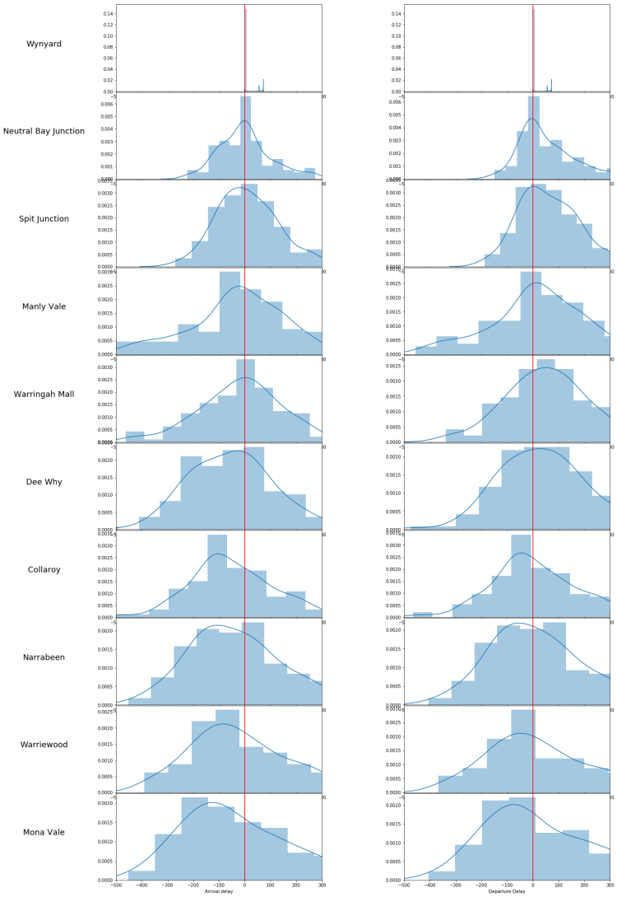
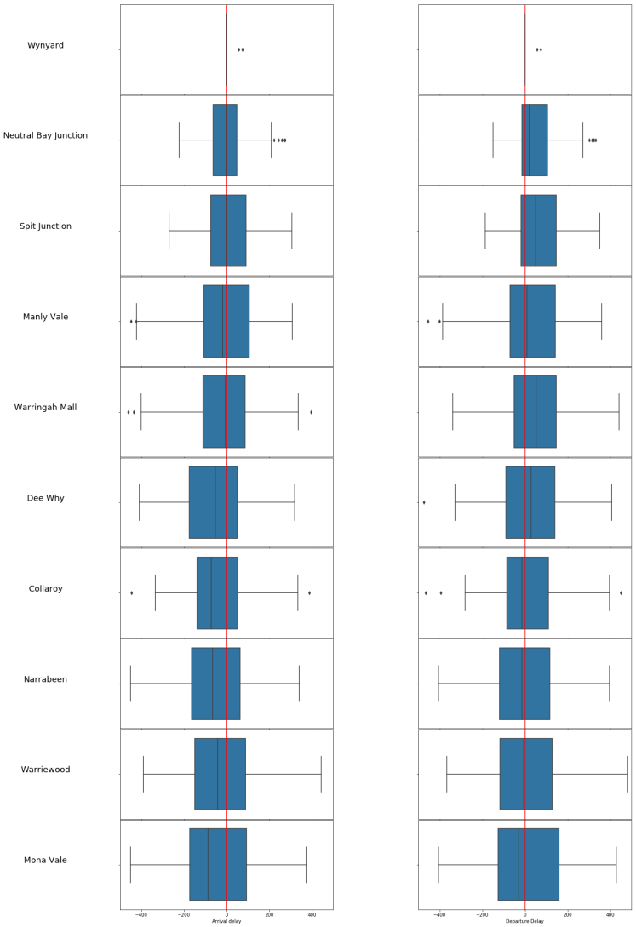
Delay Distribution for each stop
Arrival Delay
Departure Delay
Arrival Delay
Departure Delay
Early Late
Early Late
Early Late
Early Late
Notes:
As you can see, there is significant variation in the delay times, ranging from 3 min early up to 3 min late.
The delay will be within this range 95% of the time.
However, we do see some buses running up to 8 minutes late. This is proportional to the gaps in the timetable.

Slide 6
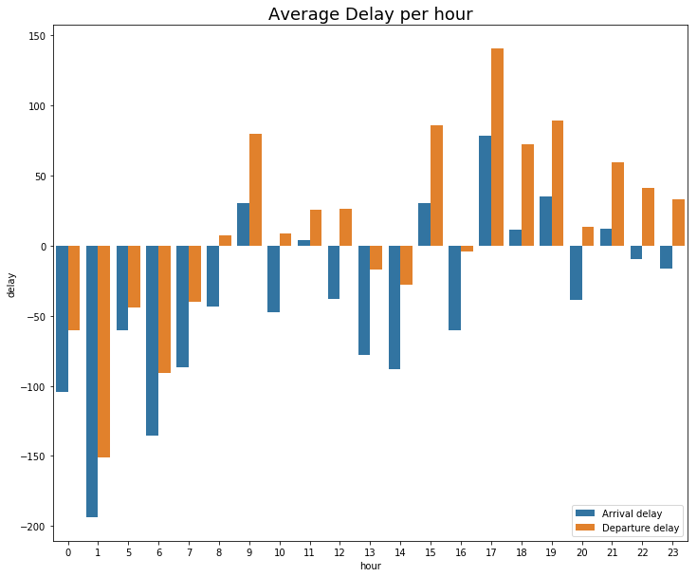
Average hourly delay
Late
Early
Notes:
On average the B1 bus arrives early each hour, but tends to depart late after morning peak times. There is significant delay in the afternoon, which may be due to people heading home from Vivid. The surrounding crowds will undoubtedly slow the buses departure from the city, which may have a significant contribution to the average delay later in the day.

Slide 7
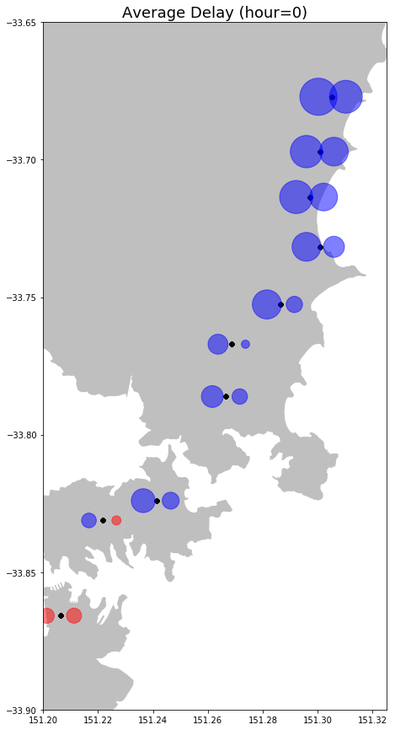
Notes:
Go to notebook.

Slide 8
Thank You

